Slide 1
Logistic Regression

Slide 2
Introduction
Logistic regression is a supervised machine learning algorithm used for classification problems, most commonly binary classification (e.g., spam vs. not spam, diseased vs. healthy).

Slide 3
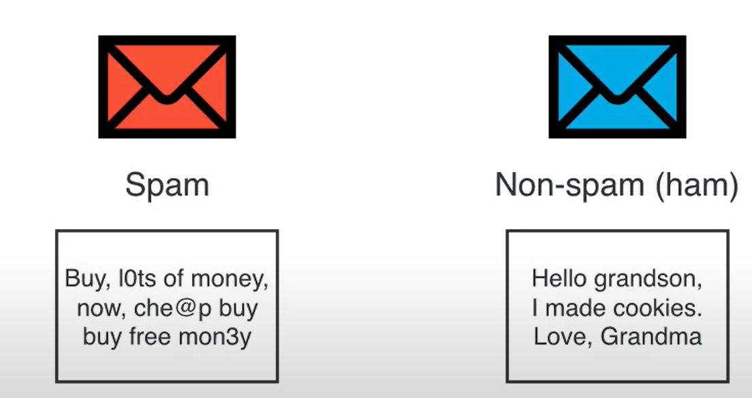
Classification - example
Spam – multiple occurrences of word “buy”, spelling mistakes

Slide 4
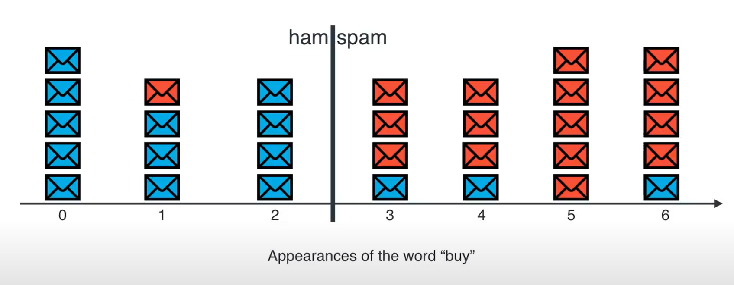
Classification - example
Rule 1: If #appearances of word “buy” > 2, then spam

Slide 5
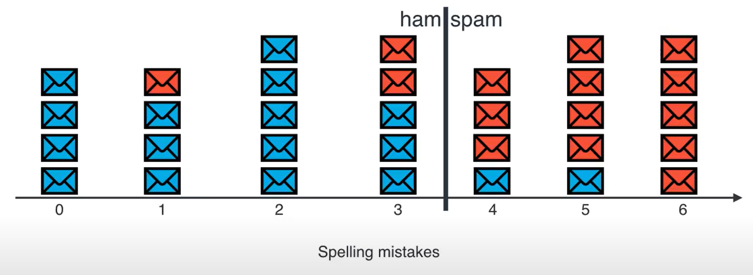
Classification - example
Rule 2: If #spelling mistakes > 3, then spam

Slide 6
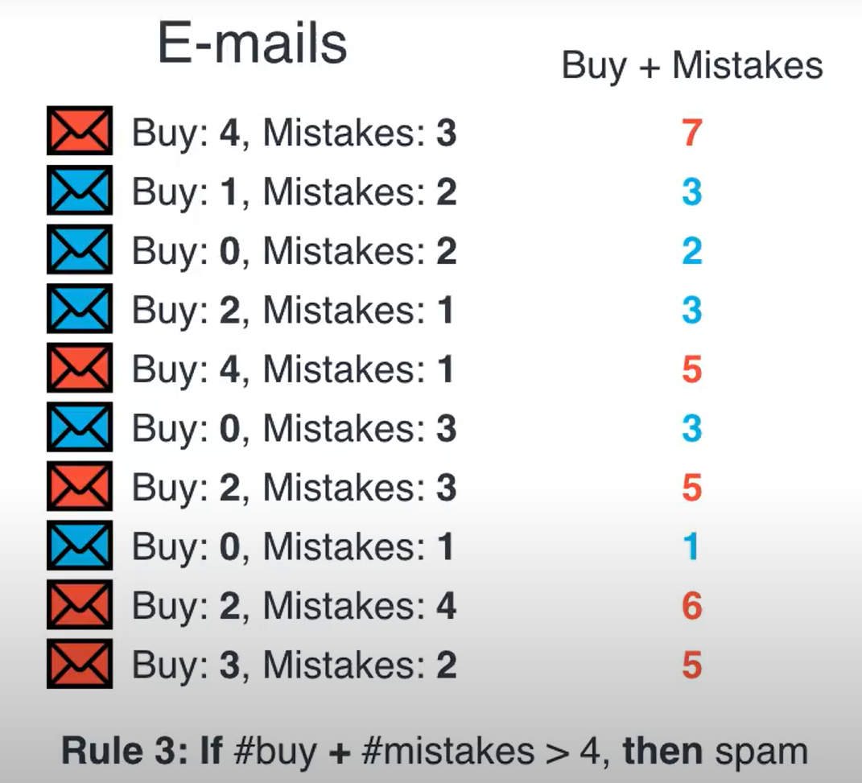
Classification - example
Combining the two rules
Rule 3: If #buy + #spelling mistakes > 4, then spam

Slide 7
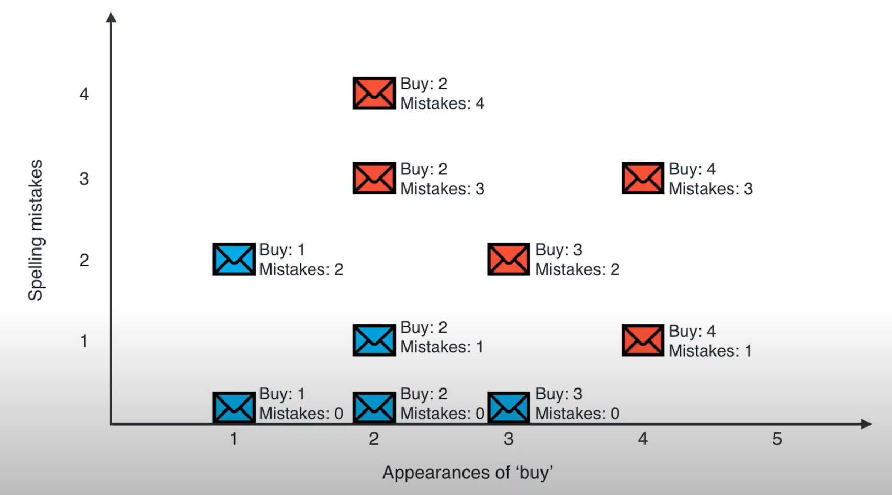
Classification - example
Graphical representation of
Rule 3: If #buy + #spelling mistakes > 4, then spam

Slide 8
Classification - example
Task is to determine the orange line that separates the two classes.

Slide 9
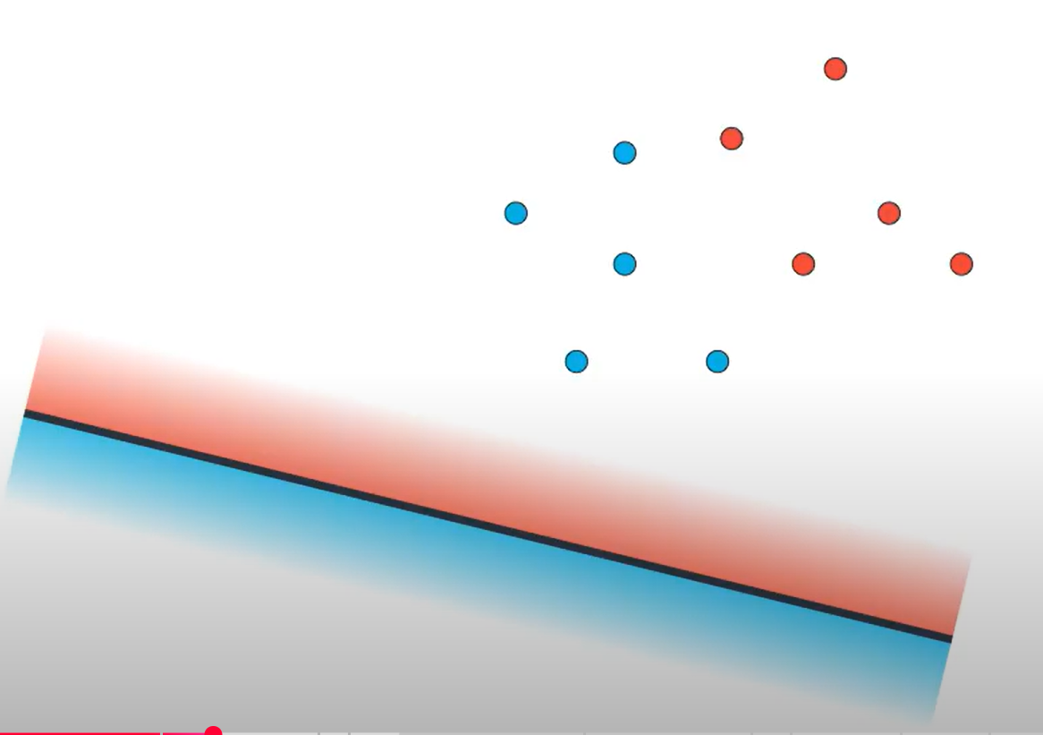
How to find the line?
The perceptron algorithm is used to determine the best line that separates the two classes.
Initially, start with a line that has two sides red and blue.
Points on the red side are classified as belonging to the red class and blue side belonging to the blue class
Initial line with red and blue sides

Slide 10
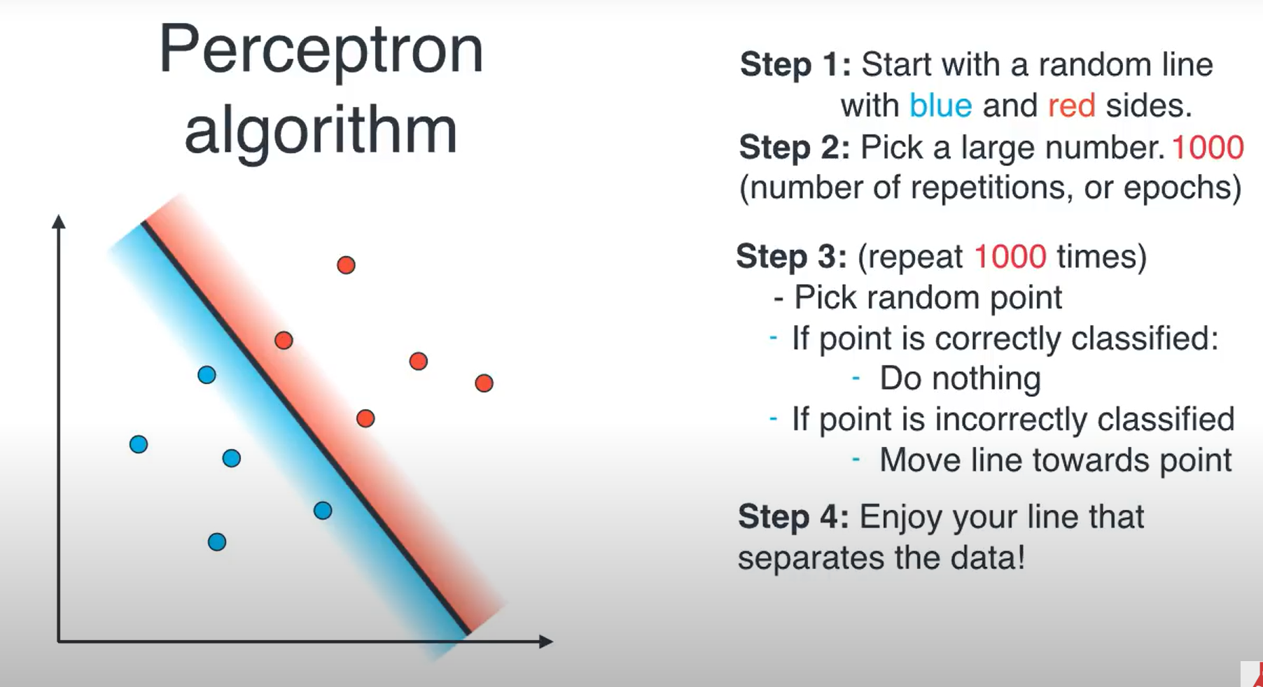
Perceptron algorithm
Initial line
Final line

Slide 11
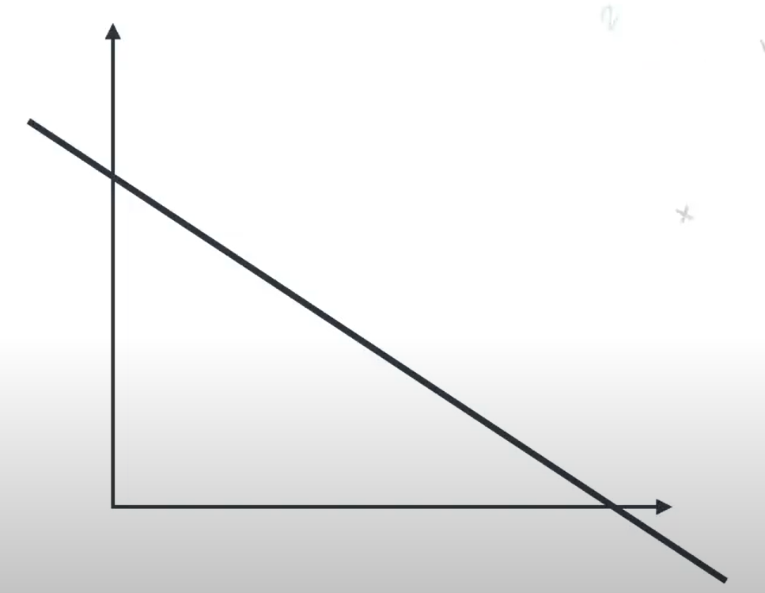
How to move the line?
Translation – moving the line up or down.
Rotation – rotating the line clockwise or counter clockwise.
Rotation along pivot on the x axis.
Rotation along pivot on the y axis.
Rotation
Translation
Rotation

Slide 12
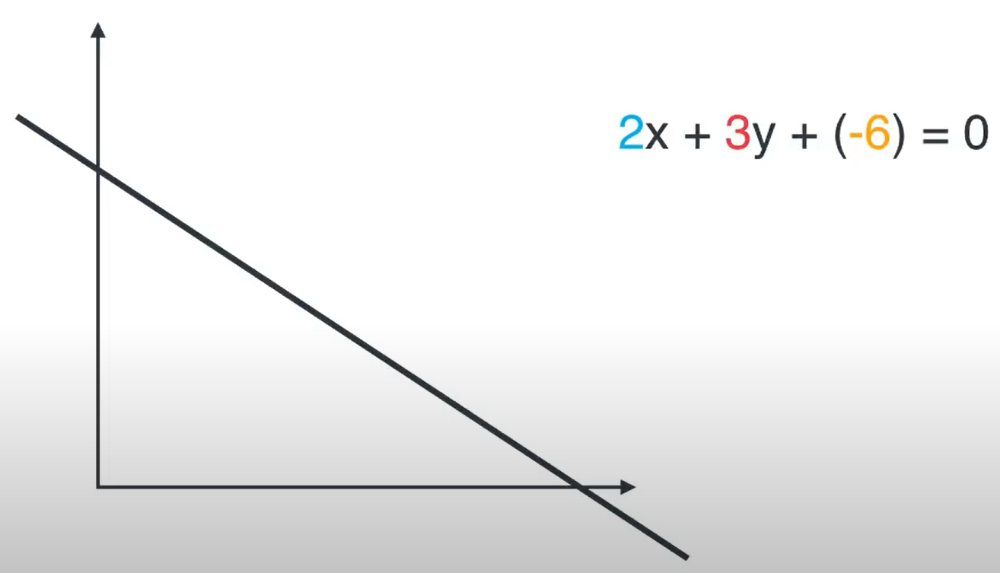
Translation
Decreasing the constant moves the line upwards.
Increasing the constant moves the line downwards.

Slide 13
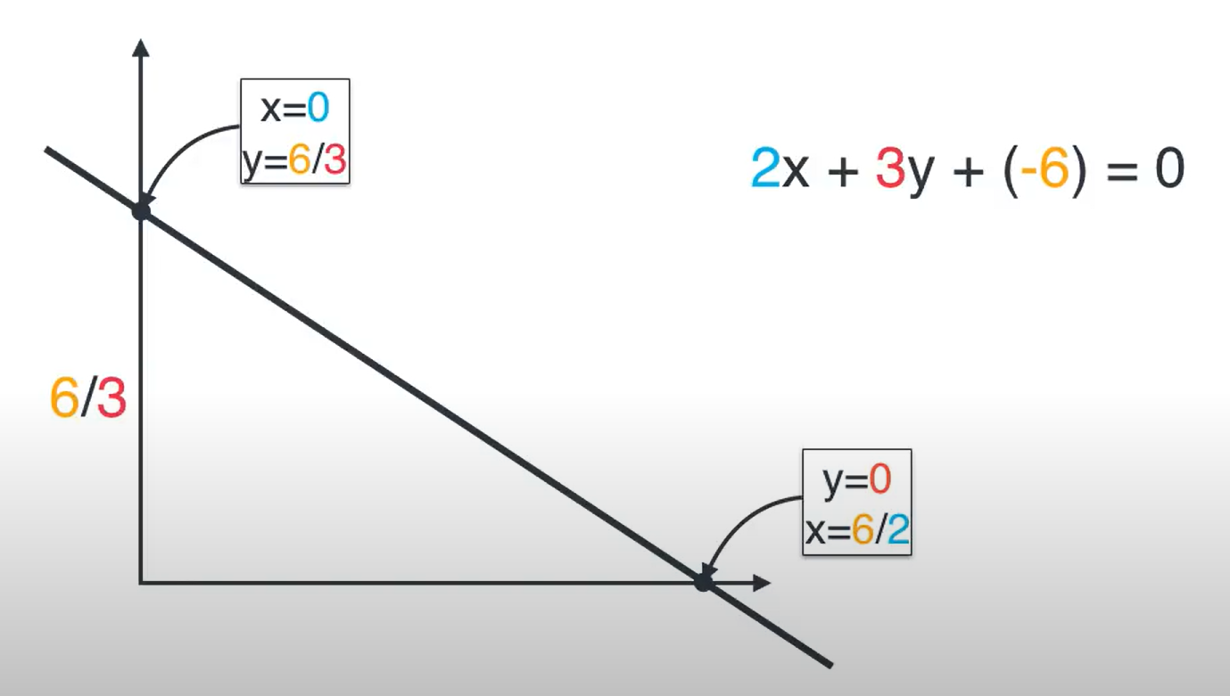
Rotation
Increasing the coefficient of x rotates the line clockwise along the pivot on the y axis and vice versa.
Increasing the coefficient of y rotates the line counter clockwise along the pivot on the x axis and vice versa.

Slide 14
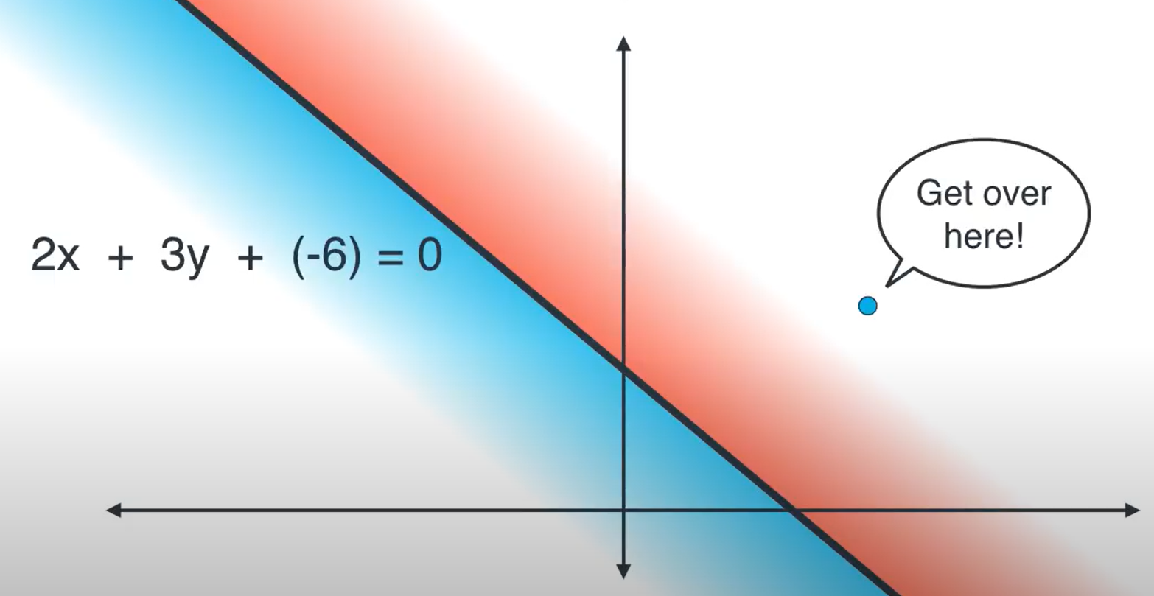
Working of the perceptron algorithm

Slide 15
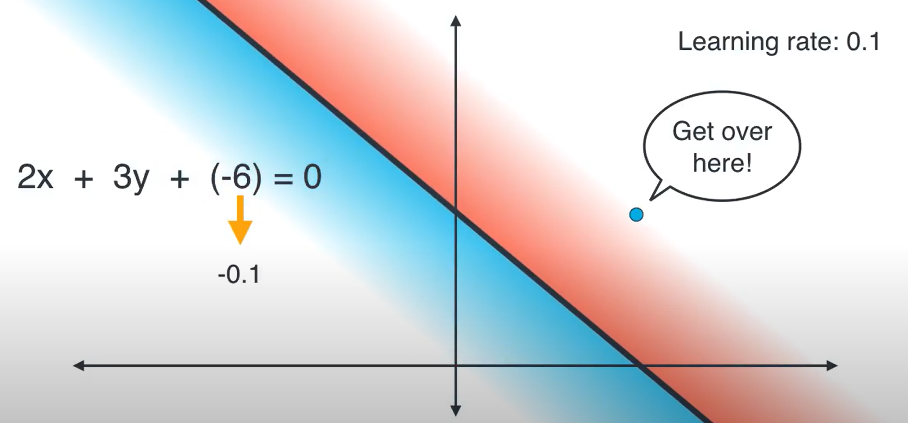
Working of the perceptron algorithm
Decreasing the constant term moves the line upwards.

Slide 16
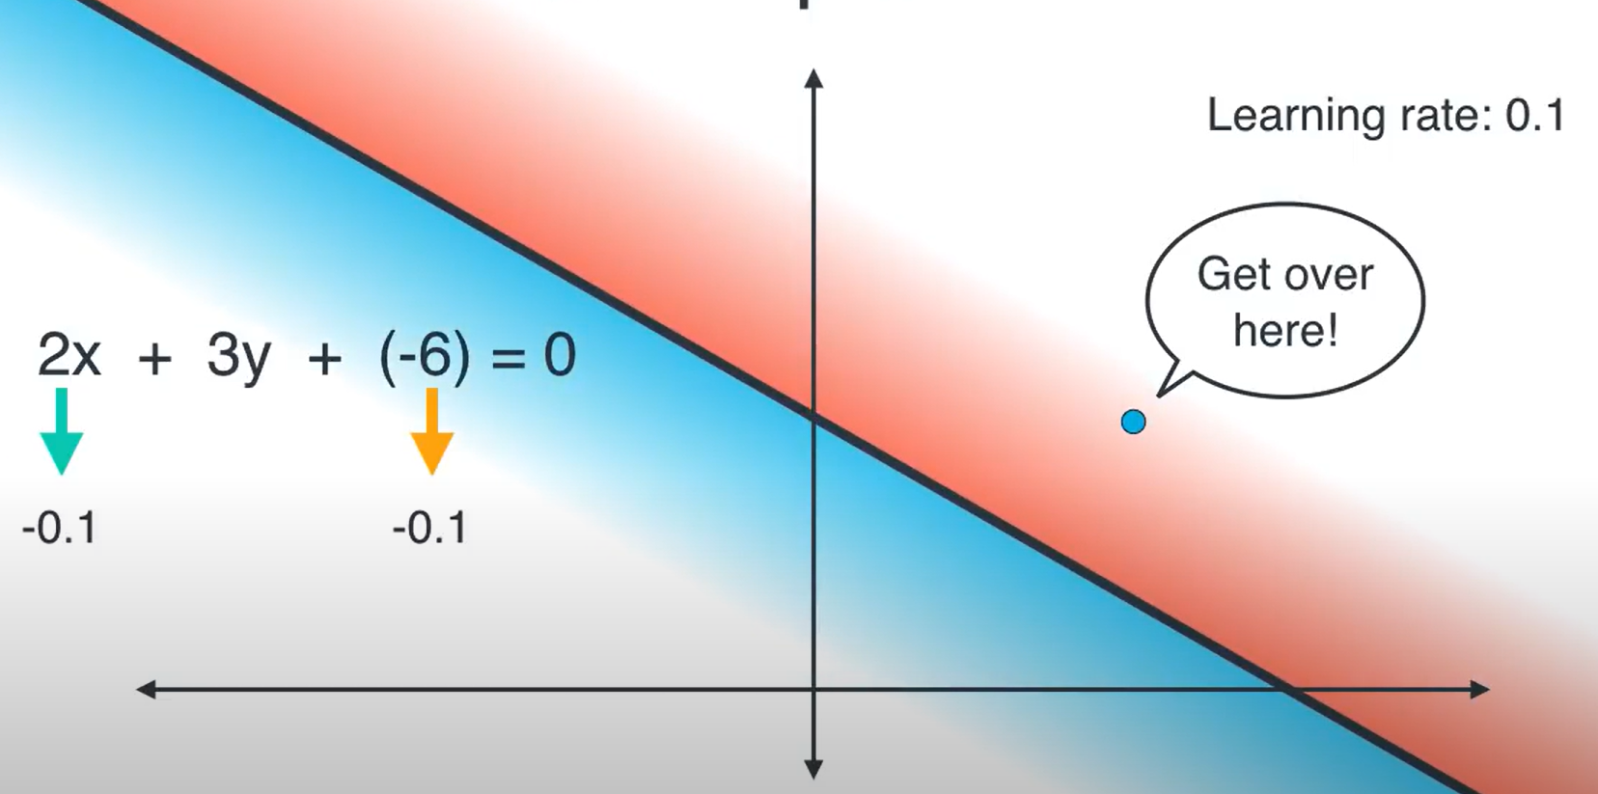
Working of the perceptron algorithm
Decreasing the x coefficient rotates the line anti clockwise along the y axis.

Slide 17
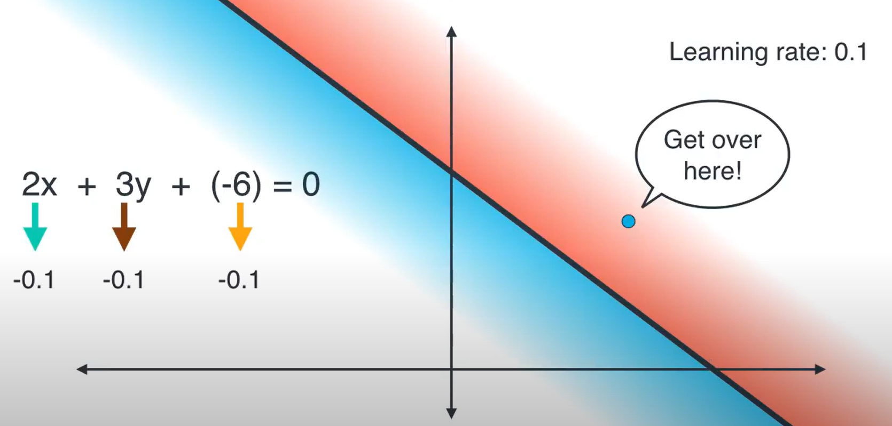
Working of the perceptron algorithm
Decreasing the y coefficient rotates the line clockwise along the x axis.

Slide 18
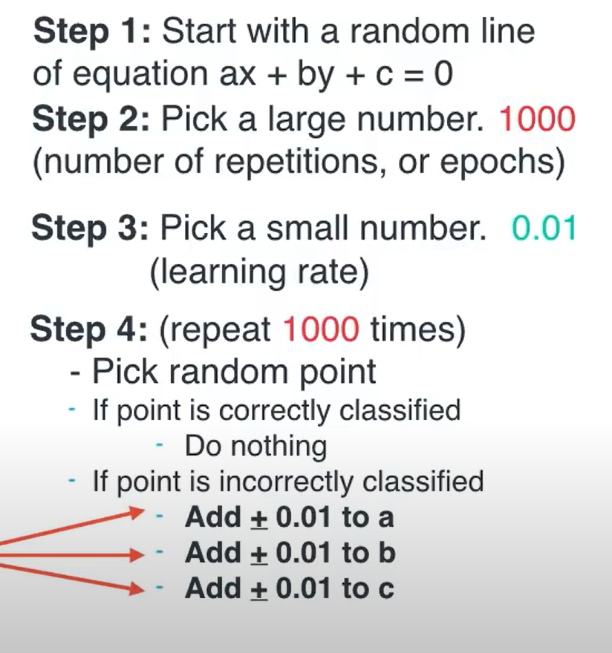
Working of the perceptron algorithm
0.1
0.1
0.1
0.1

Slide 19
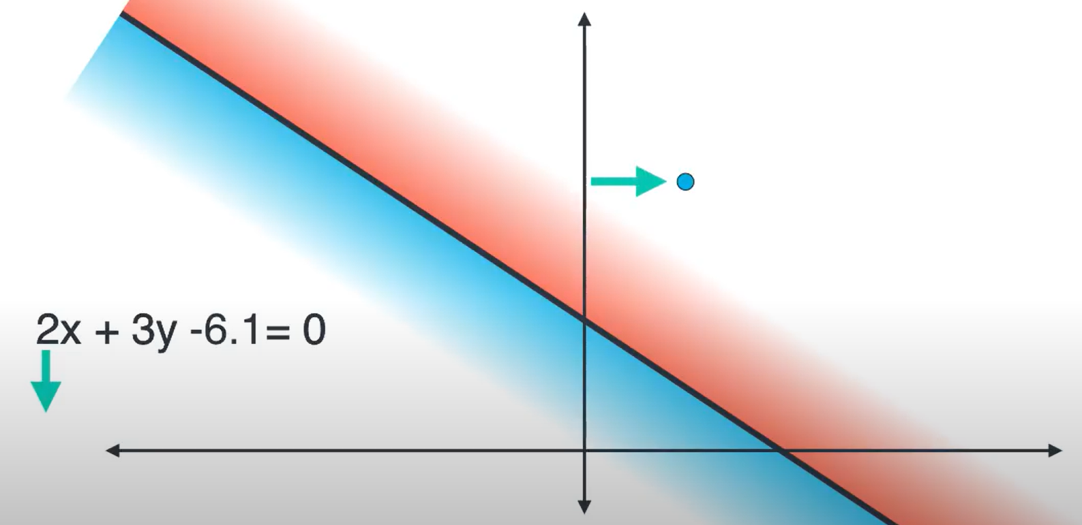
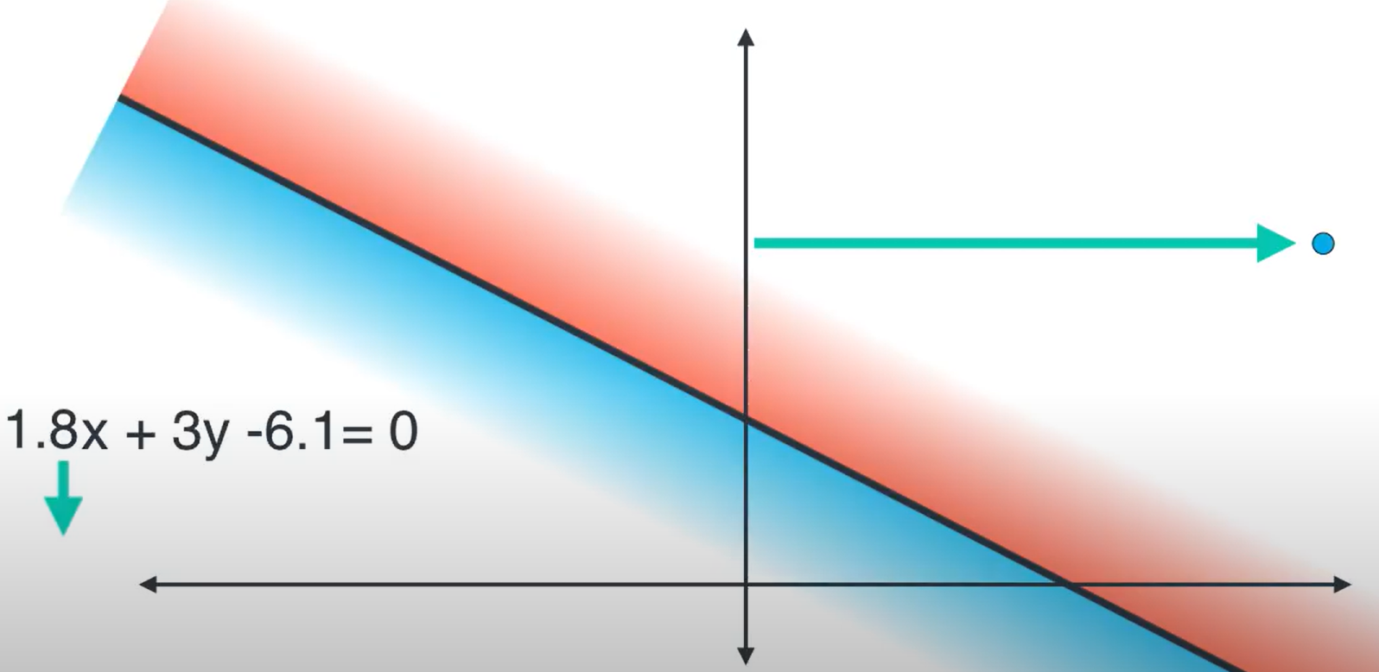
Issues with this approach
Case 1: When the data point is closer to the line
Learning rate = 0.1
Fewer movement of the line would be required to correctly classify the data point
Case 2: When the data point is far from the line
Learning rate = 0.1
More movement of the line would be required to correctly classify the data point
The problem arises as a fixed learning rate is used to move the line closer to a point

Slide 20
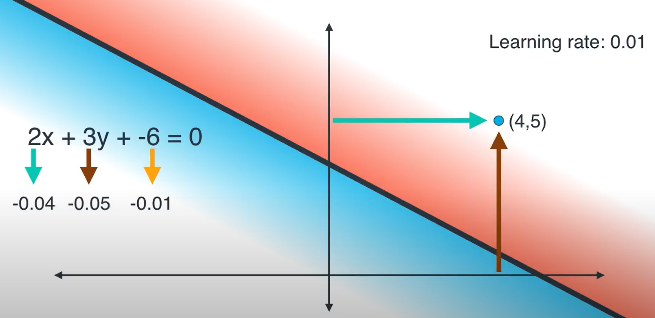
Solution
Multiply x coordinate of the data point with the learning rate. Reduce the result obtained from the x coefficient.
Multiply y coordinate of the data point with the learning rate. Reduce the result obtained from the y coefficient.

Slide 21

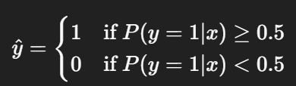
Mathematical model
Linear combination of features
z = w₀​+w₁​x₁​+w₂​x₂​+…+w_{n}​x_{n}​
Sigmoid function
P(y=1∣x) = σ(z) =
where, P(y=1∣x) – probability that the output belongs to class 1
w_{i} – model coefficients
x_{i} – feature values

